Slide 1
Behavioral consistency Analysis for job interviews
Leon Tan
Yu cheng

Slide 2

Thoughts of an interviewer
Is the candidate really saying who he said he is?
How do I know his experience is real?
Is he trying to smoke me?

Slide 3
Some solutions
A technique used by job interviewers
Repeat the same question but in various forms
Detect if reply is inconsistent with his previous replies
Determine whether the interviewee is being honest
Or his/her whether thought process is clear

Slide 4

Purpose of project
Determine the performance of a candidate for a job interview through
Video
Audio
Text analytics
Not applicable in Europe due to privacy laws

Slide 5
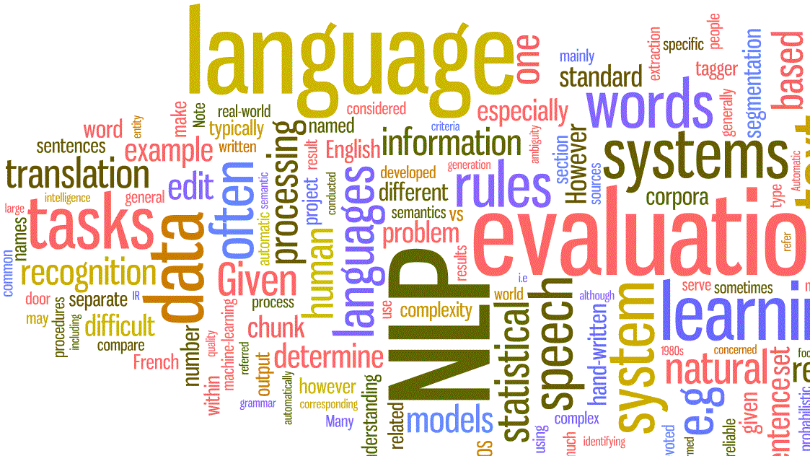
Text Analytics
Uses Natural Language Processing
Candidate fills a form from the company’s website
Or text may be converted from an audio or video source
Compare text across all inputs from the candidate

Slide 6

Audio analysis
Detect change of tones in the voice
Pauses between words or sentences
Speed of talking
Etc.

Slide 7

Video Analysis
Facial expressions
Body language
Reaction to topics of interest

Slide 8
Microsoft Cognitive services
Detects emotions of a person’s face in images or videos
https://azure.microsoft.com/en-us/services/cognitive-services/emotion
Convert speech to text
Process natural language

Slide 9
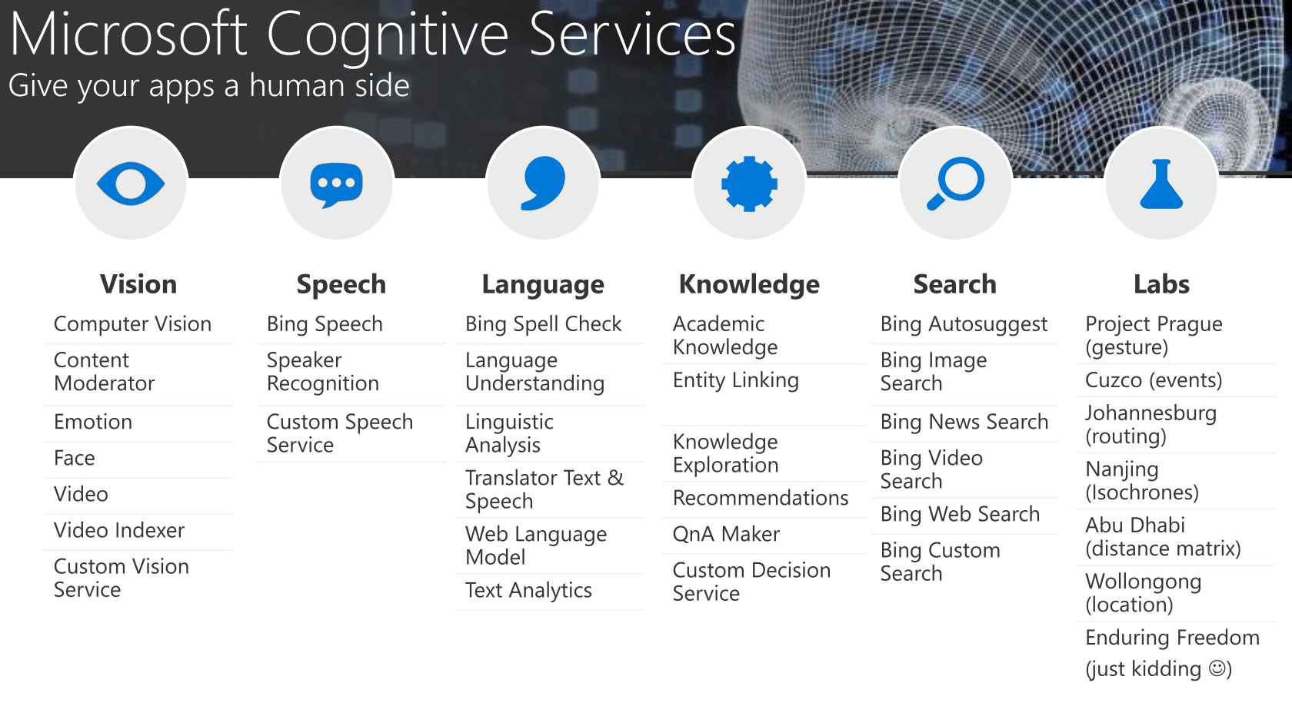

Slide 10
Whats Next?
Work with psychologist to determine patterns of behavior
Build a machine learning model
Develop a Natural Language Processing model
Gather more data

Slide 11
Thank you!

